Slide 1


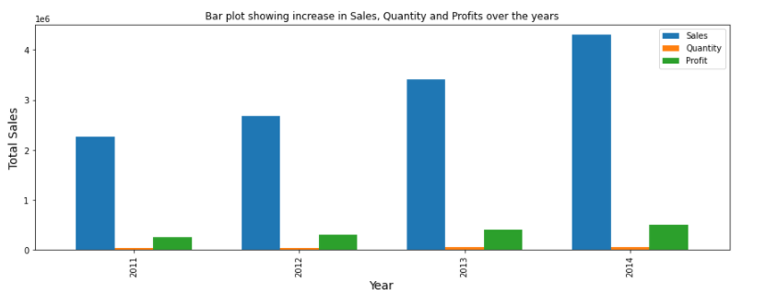
The Global Superstore
Global Superstore is an online retailer based in New York. It aims to be a one stop shop for its customers, hailing from 147 different countries. The customers can browse through a broad product category catalogue of more than 10,000 products. The dataset consists of 51k rows of data on purchases made around the world by the segments, consumers, corporate and home office. This large section comprises three main categories: 1. Office supplies 2. Furniture 3. Technology
Sales +90.31%
Profit +102.52%
Vijeta Karkera Lisa Harrell Roger Palacios

Slide 2
Agenda
Category Purchases
Segment Purchases
Country Purchases
Profit Contributors
Summary

Slide 3




Questions
What are people buying?
Which segments accounts for the majority of purchases?
Which countries accounted for the greatest profits?
What factors contributed to the Profits?

Slide 4
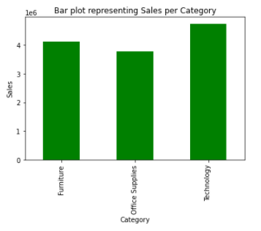



What are people buying?
Category | Sales
 | $4.110 M
 | $3.787 M
 | $4.744 M
Furniture
Office Supplies
Technology

Slide 5
Categorical analysis using Chi-Square
Null Hypothesis: No statistical significance exists in the distribution of the orders placed by the three segments: corporate, consumers and home office.

Slide 6



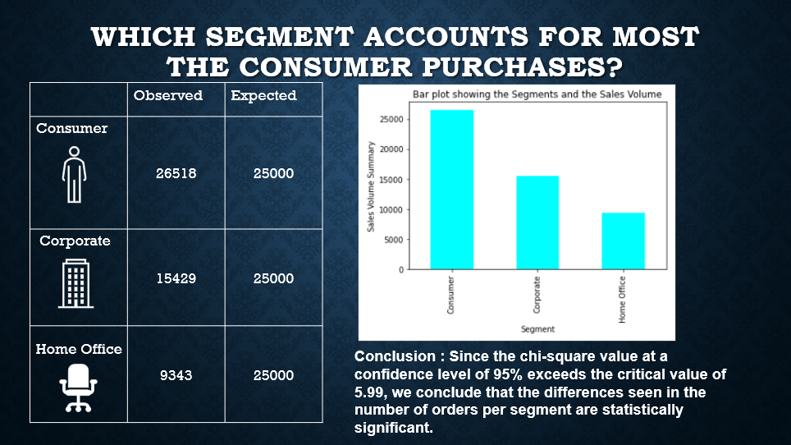
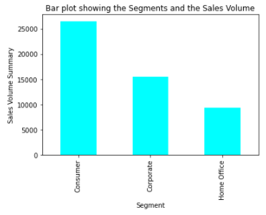
Which segment accounts for most the consumer purchases?
 | Observed | Expected
 | 26518 | 25000
 | 15429 | 25000
 | 9343 | 25000
Consumer
Corporate
Home Office
Conclusion : Since the chi-square value at a confidence level of 95% exceeds the critical value of 5.99, we conclude that the differences seen in the number of orders per segment are statistically significant.

Slide 7

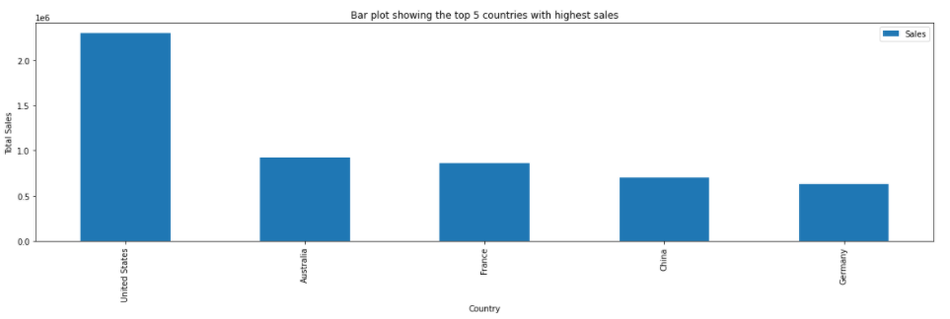
Which countries accounted for the greatest profits?
Country | Profits
United States | $2.297 B
Australia | $9.252 M
France | $8.589 M
China | $7.005 M
Germany | $6.288 M

Slide 8
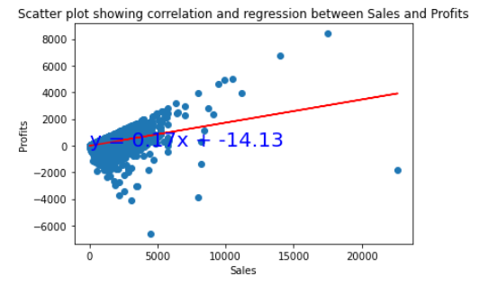
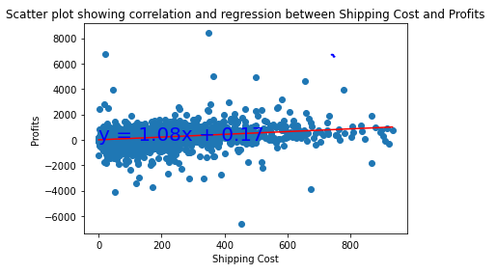


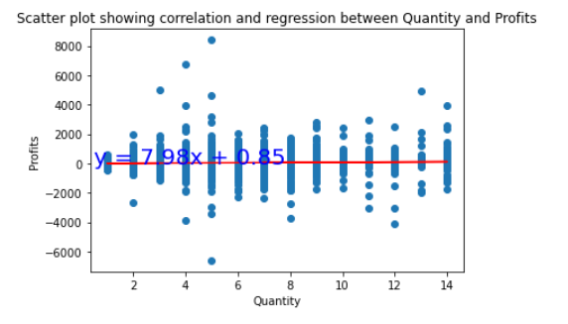
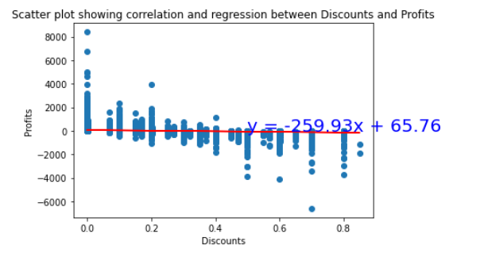


What factors contributed to the Profits?
Sales
Shipping
The correlation between sales and profits is 0.48
The correlation between shipping and profits is 0.35
Quantity
Discounts
The correlation between quantity and profits is .1
The correlation between discounts and profits is -0.32

Slide 9
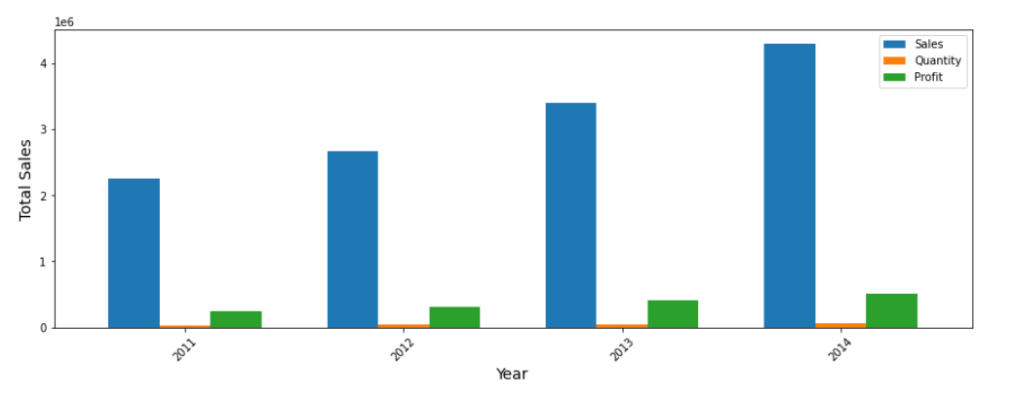
Conclusion
Sales +90.31%
Profit +102.52%
The correlation coefficient of -1 indicates perfect negative correlation, 1 indicates perfect positive correlation, and 0 indicates no correlation.
The results indicate that there is no significant relation between profits and discounts, quantity and shipping cost. However, there is slight positive correlation between sales and the profits.
Global Superstore's largest demand comes from the U.S, Australia, France, China and Germany.
The segment that is contributing to the highest sales is the Consumer market, followed by Corporate and Home office.
The product category that has resulted in highest sales over the years is Technology, followed by Furniture and Office supplies

